Slide 1

WELCOME NAAC COMMITTEE

Slide 2

SARA
Voice Assistant
…Eyes Beyond…
Yash Patil
Sanaya Surde
Apurva Sanap
Harshit Thakre
Vinay Bahire
Siddharth Ohal

Slide 3

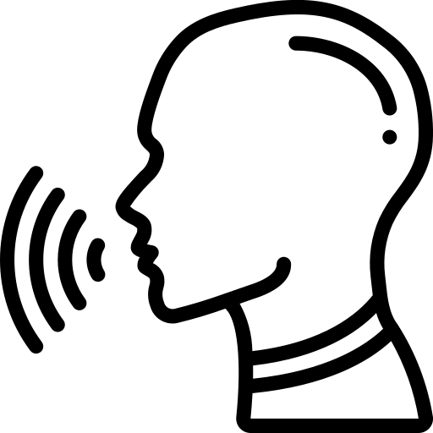





Stand by
Generate
Response
Analyzing
Voice input
Processing commands
User
Mic
Command
executed

Slide 4
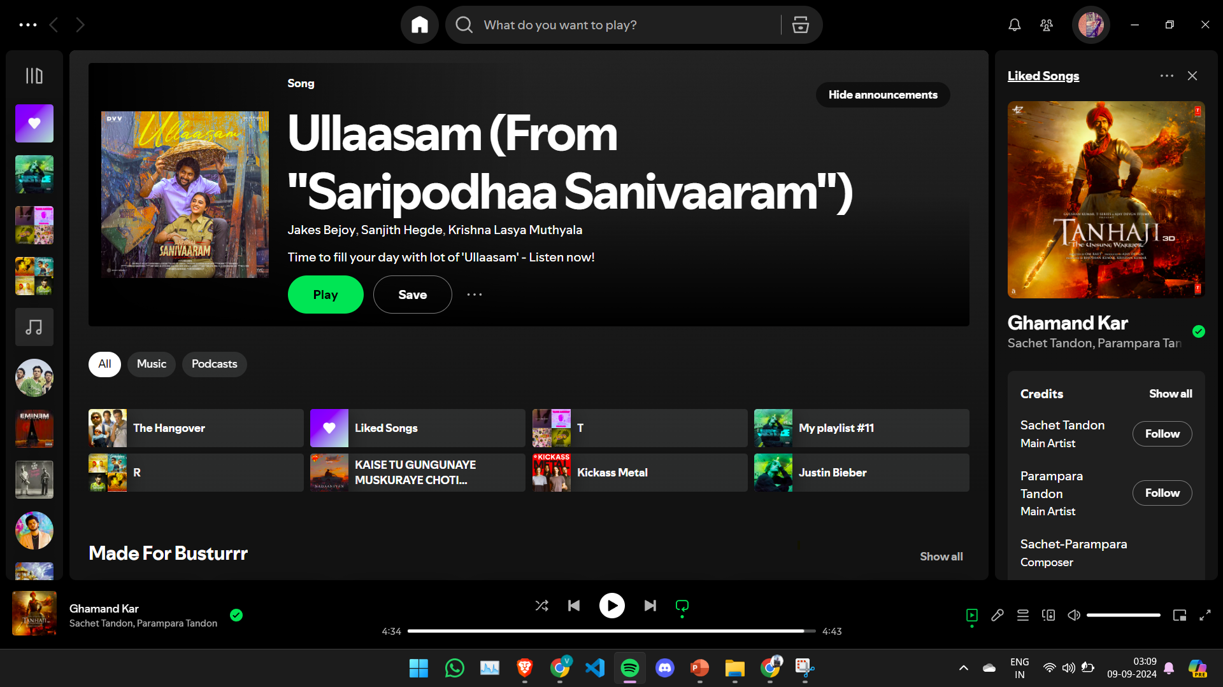
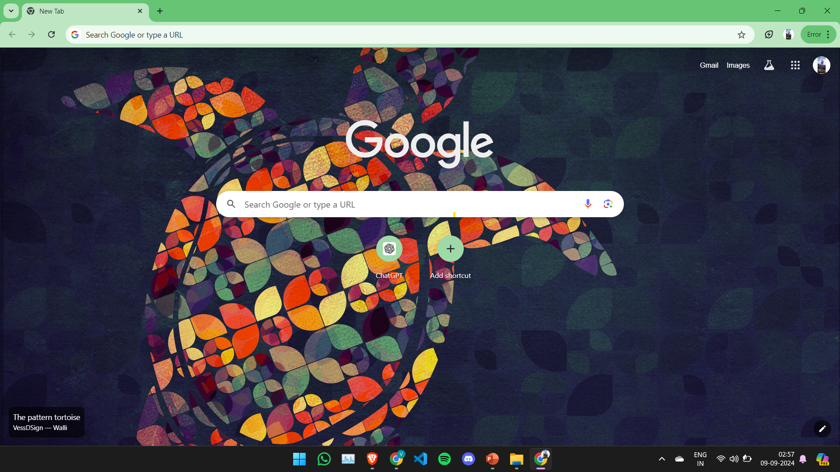
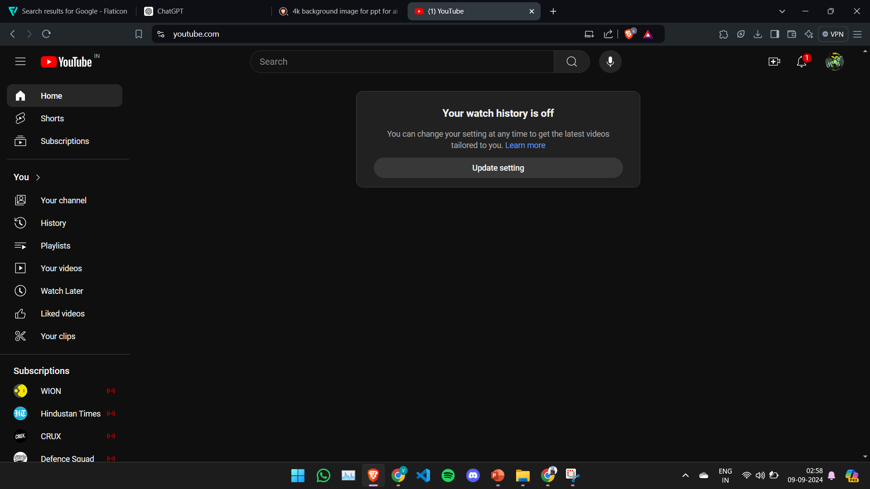
Hey SARA,
Launch Youtube
Hey SARA,
Launch Google
Hey SARA,
Launch Spotify
Launching
Spotify
Launching
Youtube
Launching
Google
Sara

Slide 5
Novelty Of SARA:
Enhanced Auditory Feedback
Multilanguage Support
Desktop Automation and Navigation
System Monitoring
Task Automation
1
2
3
4
SARA
5

Slide 6
Sara’s Functionality Module
User Interaction Module
Output & Feedback Module
Voice Recognition Module
Task Execution
Module
NLP Module

Slide 7
Technical Requirements
Speech
Recognition
PyCharm
IDE
Desktop
Platform
Technical Requirements
Natural
Language
Toolkit
Operating
System
(Windows& Linux)
Python Libraries
Google
Speech to text API
Micro-phone

Slide 8

Future Scope and Goals
AI Advancements
Deep Learning Integrations
Emotion Recognition
Haptic Feedback
Dialect Support
Wearable Device Integration
IOT Inclusion
Cloud Based Integration
Global Accessibility
Enhanced Privacy and Security

Slide 9
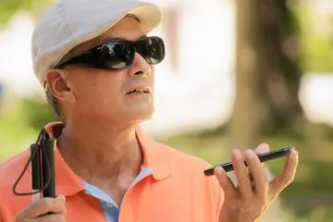
Conclusion
Voice Assistant technology can truly revolutionize accessibility and help millions of disabled individuals achieve greater independence. By providing hands-free voice control of their systems, speech recognition technology opens up a new way for human interaction with machines, greatly benefiting physically challenged individuals.
SARA
Eyes Beyond

